Slide 1
NACHCs Policy & Issues Forum 2026
Gaylord National Harbor, Washington, DC
Committee & Task Force Meetings: February 8
Conference: February 9 - 12
Capitol Hill Day – Wednesday, February 11
- Full Conference Agenda -
California Delegation Meeting Hosted by CPCA Advocates
Tuesday, February 10 at 5:45 PM/ET
Room: Maryland C
CPCA Advocates Member Prep Webinar

Slide 2
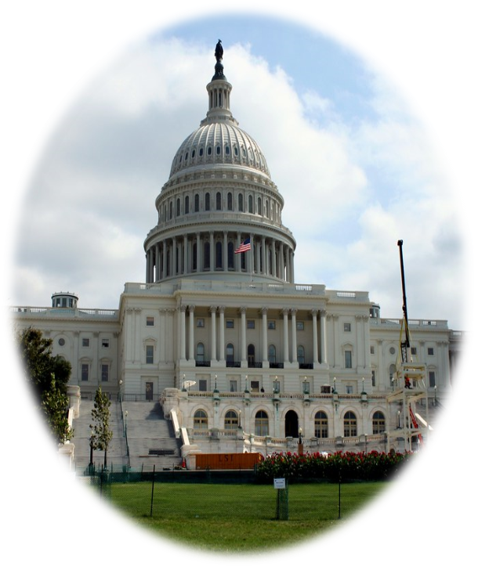
Agenda
Welcome
Political Landscape in D.C.
NACHC’s Policy Agenda
California Priorities
Congressional Hill Visits & Logistics
Advocacy & Social Media
Q & A

Slide 3
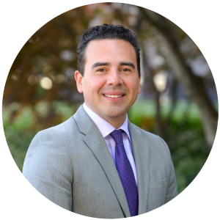
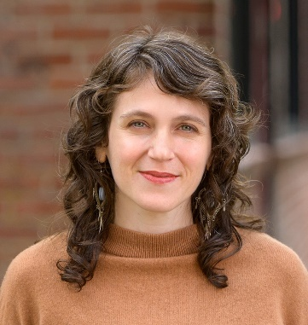
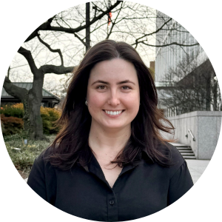
CPCA Advocates Team
Dennis Cuevas-Romero
Vice President of
Government Affairs
Laura Sheckler
Director of Budget Advocacy and Strategic Policy
Anna Marshall
Deputy Director of
Federal Affairs & Policy

Slide 4
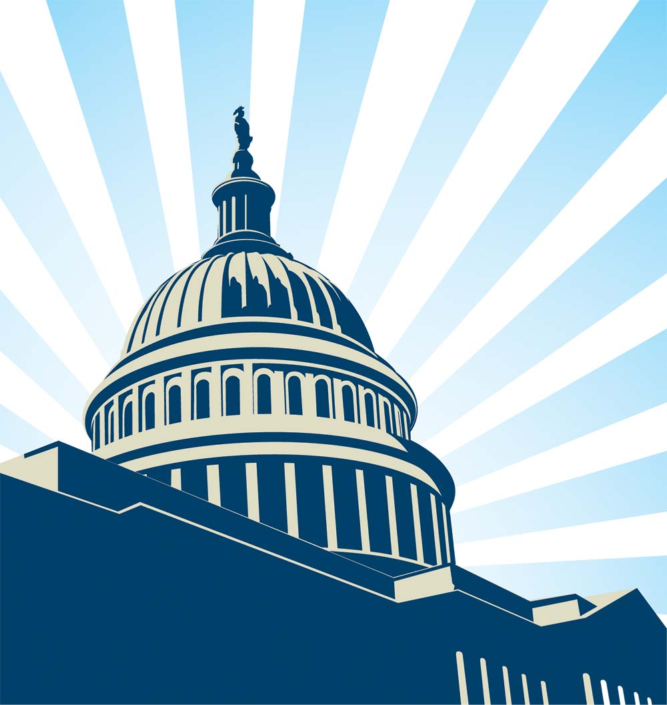
Federal Landscape

Slide 5
DHS and Spending Bills
We may still be in a partial government shutdown -
If this is the case:
ICE activities impact on health centers and the communities they serve
Health center funding and telehealth regulatory uncertainty
If we have exited the shutdown, Congress may be considering reforms to the DHS spending bill / ICE oversight.
If this is the case:
ICE activities impact on health centers and the communities they serve

Slide 6
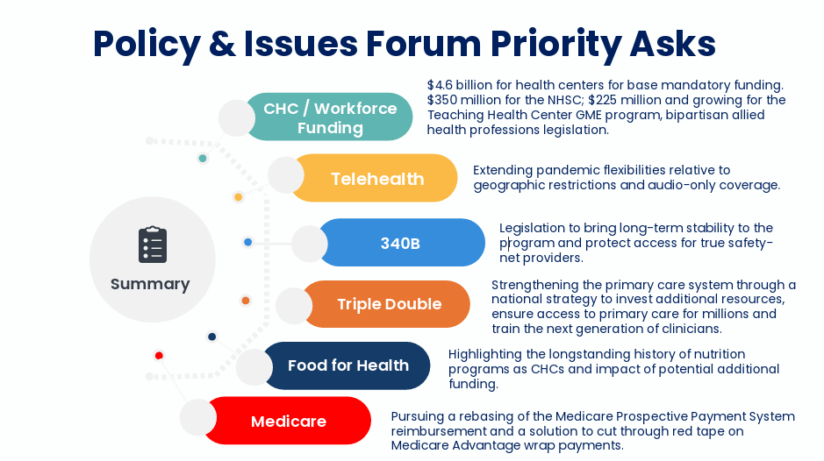
NACHC’s Policy Agenda
NACHCs Webinar Recording:

Slide 7
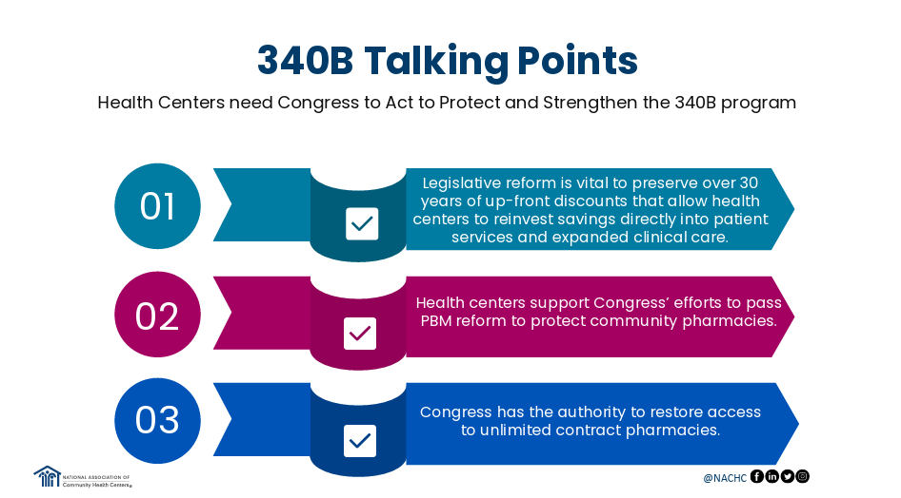
NACHC - 340B
ASK: Cosponsor the Community Health Center Drug Pricing Protection Act (Rep. Bergman (R-MI-1) and Rep. Auchincloss (D-MA-4))
CPCA Advocates has endorsed this bill!

Slide 8
California Top Priorities
HR1 Impacts to California CHCs
  In California, up to 2 million Californians may lose Medi-Cal coverage.
  Tens of billions of federal funding for California's Medicaid program will be cut.
  We will have a major disruption to the Medi-Cal financing structure for safety net providers like CHCs.
California State Budget Impacts to CHCs
  The California State Budget of 2025-26 and the proposed budget for 2026-27 impose sweeping cuts towards Medi-Cal coverage for UIS patients, walking back decades of advocacy to expand health care to all Californians, regardless of immigration status.
  Beginning July 1, 2026, CHCs will lose PPS reimbursement for state-only funded services provided to individuals with unsatisfactory immigration status (UIS) and instead receive reimbursement at a significantly lower Medi-Cal fee-for-service rate. This cut places serious financial constraints on CHCs.
California Clinic Ballot Initiative One Pager
  The statewide ballot measure would divert billions of dollars away from patient care into new state bureaucracy, forcing health centers and clinics to drastically reduce patient services and even close.
Department of Homeland Security and ICE Oversight
  Emphasize ICE activities' impact on health center patients and the communities health centers serve. Speak to the harm escalating ICE activity does to health center patients, operations, and staff.
  More information on Immigrant rights organizations' congressional advocacy can be found here: National Immigration Law Center

Slide 9
CPCA Advocates Materials
CPCA one-pagers to compliment NACHC and RAC materials:
CPCA 2025 State Profile
HR1 Impacts to California CHCs
California State Budget Impacts to CHCs
California Clinic Ballot Initiative One Pager

Slide 10
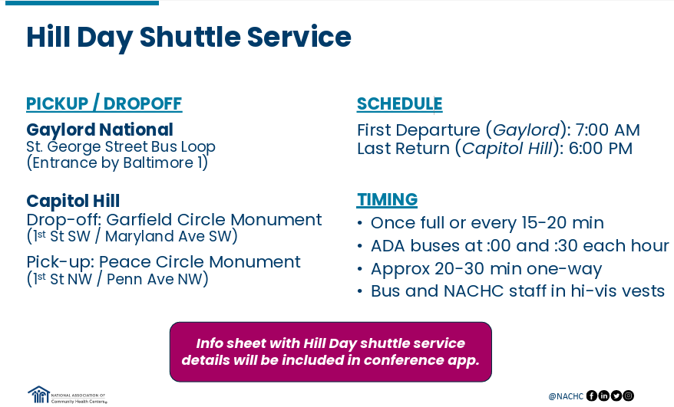

Slide 11
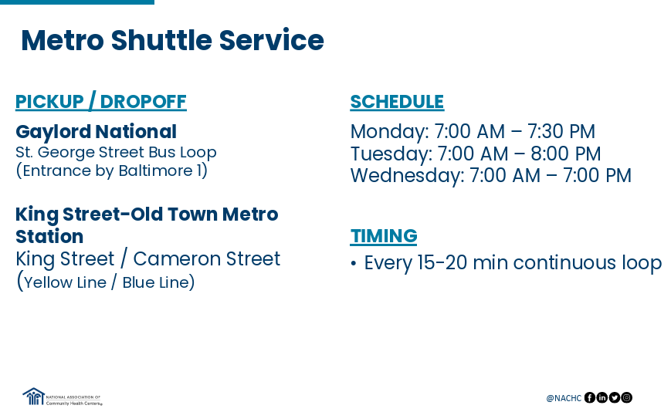

Slide 12
Hill Visits – Best Practices
Coordinate with meeting attendees in advance. (Before you go to DC or at the CPCA Advocates State Delegation meeting)
Ensure meeting attendees know the meeting date, time, and place for the meeting. (Meet outside the office at least 10 min prior)
Research the members/staffers you will be meeting with beforehand.
Stay on topic and focus on issues relevant to your health centers.
Tailor messaging and highlight constituent stories.
Be specific with the ASK and gain commitment!
If appropriate, ask members/staffers to take a picture.
Thank Members of Congress and their staff for their support and offer to provide additional follow-up information as needed.

Slide 13
Hill Visit Follow-Up
Have a follow up plan
Send a thank you note to the member/staffer.
Send electronic leave-behind packet and other information requested during the meeting via email.
Invite your member/staffer to visit your health center in their district.
Post on social media using the appropriate platform
Add a photo or two
Use the event hashtags
Tag the member, health center, and @CPCAadvocates
Thank the member/staffer you met with on social media

Slide 14
Use Social Media at P&I
Use the appropriate social media platform.
  X (Twitter), Facebook, or Instagram
  Tag @CPCAAdvocates and @NACHC
Add a photo or two to your post.
Post about the event and why you are in D.C. (or virtual!)
Share why you are passionate about community health centers!
Bring awareness to a subject by using hashtags: #NACHCEvents #ValueCHCs #340B
Share the content of others. Make sure to follow the hashtags to stay engaged.
Connect with an individual, legislator, or organization by tagging them in your posts.
Notes:
Reminder we have a list of social media handles on our website that are for reference by district!

Slide 15
Questions?

Slide 16
Contact Us
Policy Priorities
  Anna Marshall – Anna@cpcaadvocates.org
Logistics & On-site Contact
Anna Marshall – Anna@cpcaadvocates.org
Laura Sheckler – laura@cpcaadvocates.org
Materials
  Kelley Aldrich - kelley@cpcaadvocates.org
Social Media
Joanna Valdez Castro - jvaldez@cpca.org
Xia Wen Guan - xwguan@cpca.org

